Slide 1
GRAPHS
Notes:
Are your classroom colors different than what you see in this template? That’s OK! Click on Design -> Variants (the down arrow) -> Pick the color scheme that works for you!
Feel free to change any “You will…” and “I will…” statements to ensure they align with your classroom procedures and rules!

Slide 2
Trees
All trees are graphs
But not all graphs are trees
A tree is a connected graph without cycles
Traversals
Preorder, inorder, postorder traversals are examples of depth-first traversal
Level-order traversal of a tree is an example of breadth-first traversal
Visit a node
For a tree: process the node's data
For a graph: mark the node as visited

Slide 3
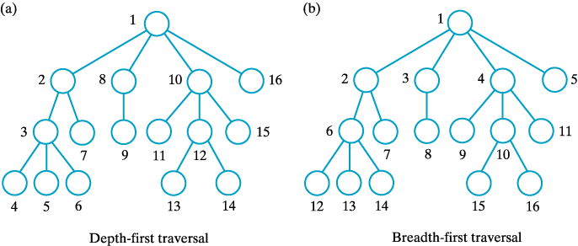
Tree Traversals

Slide 4
Graph Traversals
There are two kinds of Graph Traversal Algorithms:
Breadth first Algorithm
Depth First Algorithm

